Slide 1
Causality, Parametric versus non-parametric
Jacob LaRiviere
Some content taken from Justin Rao and Brian Quistorff

Slide 2
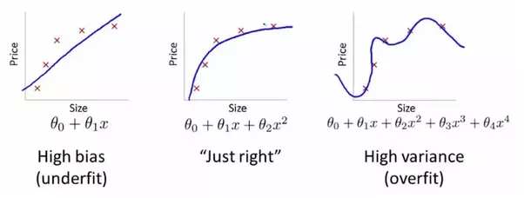
In ML bias refers to a model being systematically wrong. - Econometricians focus on parameters which are systematically wrong or “biased” In ML variance refers to a model changing a lot as a function of a new sample of data. - glmnet is the main R package: https://web.stanford.edu/~hastie/glmnet/glmnet_alpha.html

Slide 3
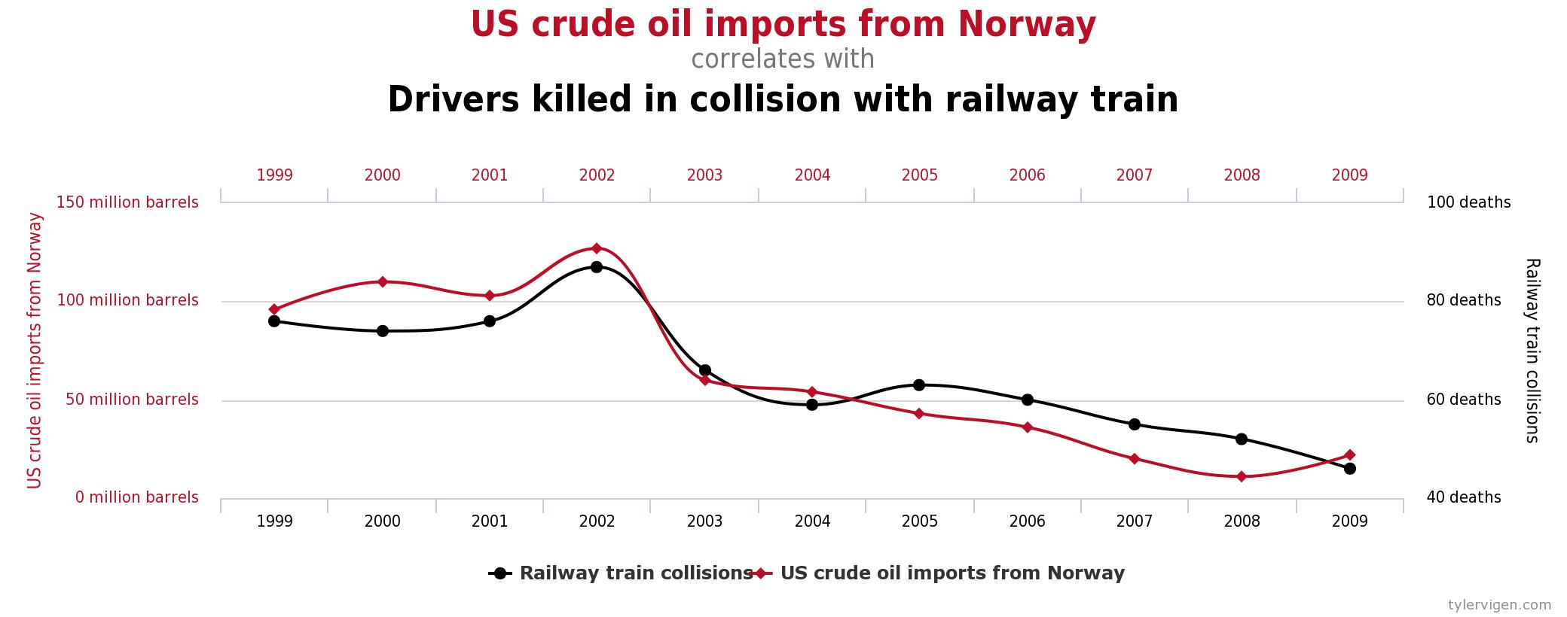
historical data is very useful but the insights from correlations in it can be random and even misleading.

Slide 4
historical data is very useful but the insights from correlations in it can be random and even misleading.

Slide 5
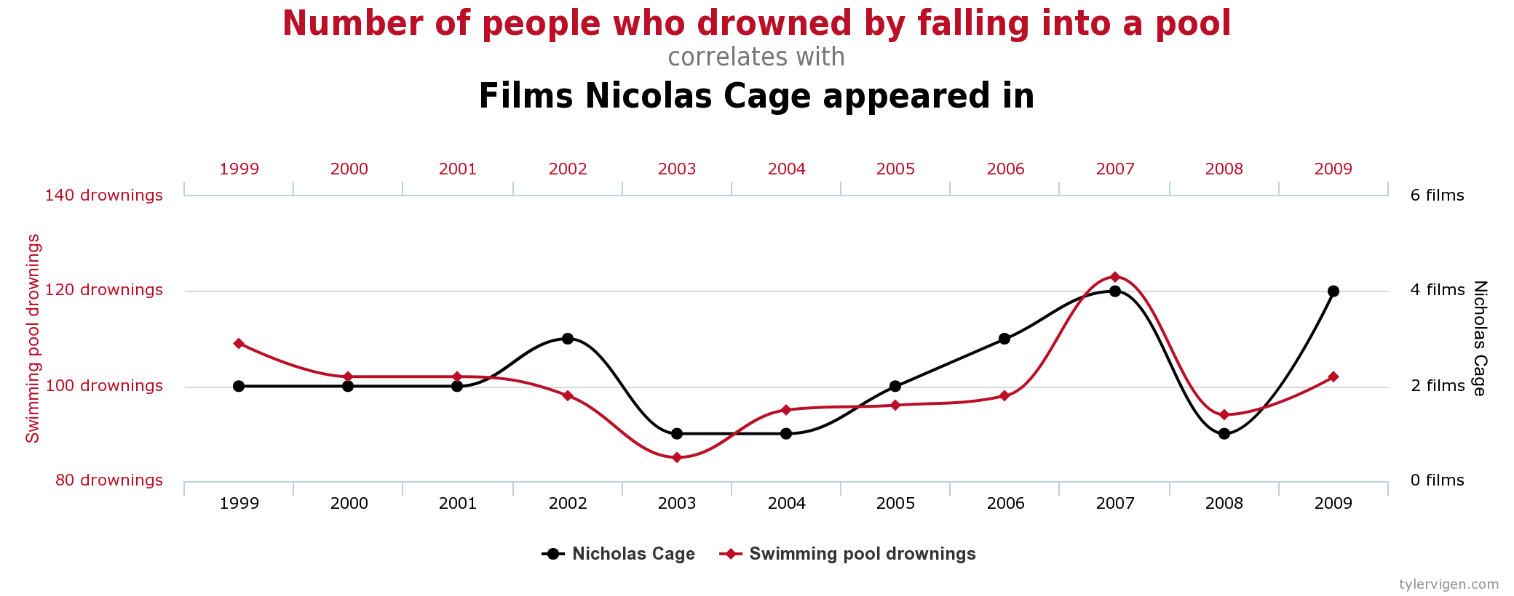
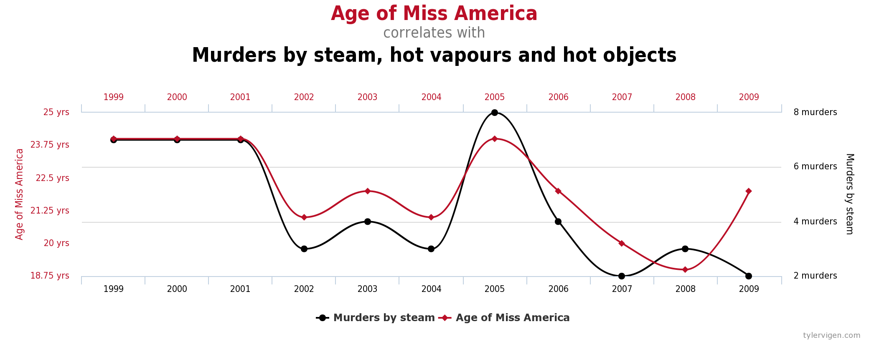
historical data is very useful but the insights from correlations in it can be random and even misleading.

Slide 6
Misleading….
Call:
lm(formula = logmove.minute.maid ~ log(price.dominicks) * feat.dominicks +
log(price.minute.maid) * feat.minute.maid + log(price.tropicana) *
feat.tropicana, data = temp)
Residuals:
Min 1Q Median 3Q Max
-2.72433 -0.37421 -0.02269 0.34076 2.72813
Coefficients:
Estimate Std. Error t value Pr(>|t|)
(Intercept) 9.94534 0.04541 219.024 < 2e-16 ***
log(price.dominicks) 0.59255 0.03308 17.912 < 2e-16 ***
feat.dominicks -0.09239 0.03240 -2.852 0.00435 **
log(price.minute.maid) -2.42169 0.04360 -55.547 < 2e-16 ***
feat.minute.maid 1.83595 0.06239 29.427 < 2e-16 ***
log(price.tropicana) 0.58930 0.03681 16.010 < 2e-16 ***
feat.tropicana 0.70944 0.07637 9.290 < 2e-16 ***
log(price.dominicks):feat.dominicks 0.04523 0.06282 0.720 0.47149
log(price.minute.maid):feat.minute.maid -1.14745 0.08246 -13.915 < 2e-16 ***
log(price.tropicana):feat.tropicana -0.94700 0.08328 -11.371 < 2e-16 ***
---
Signif. codes: 0 ‘***’ 0.001 ‘**’ 0.01 ‘*’ 0.05 ‘.’ 0.1 ‘ ’ 1
Residual standard error: 0.5745 on 9639 degrees of freedom
Multiple R-squared: 0.6604, Adjusted R-squared: 0.6601
F-statistic: 2082 on 9 and 9639 DF, p-value: < 2.2e-16

Slide 7
Misleading…. log(price.minute.maid):feat.minute.maid -1.14745 0.08246 -13.915 < 2e-16 ***
Do we really believe this?
This says that demand is more elastic when a product is featured.
Alternative explanation: when a product is featured it is more likely to be discounted. If more likely to be discounted then this could conflate the elasticity feature effect and the elasticity effect
(e.g., only not discounted but not featured during particularly odd dates).
Another example: using Christmas advertising to estimate effect of advertising on sales.

Slide 8
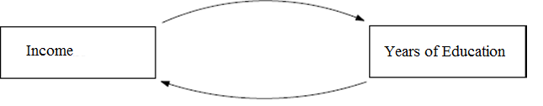

Slide 9
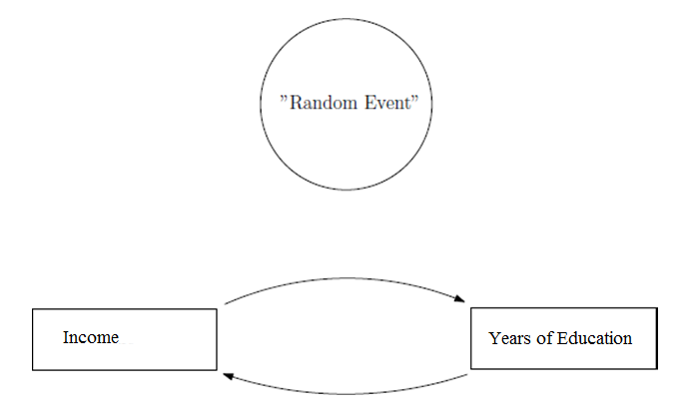

Slide 10
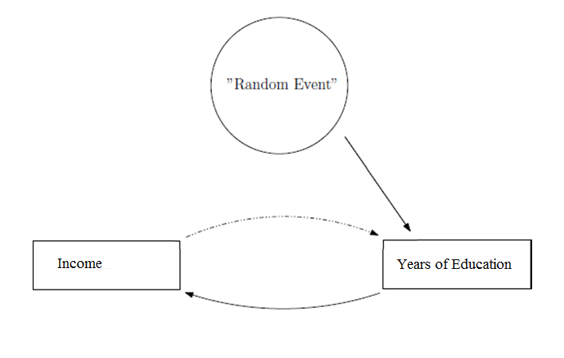
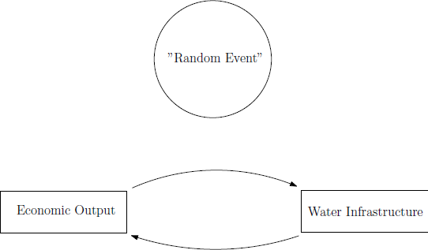
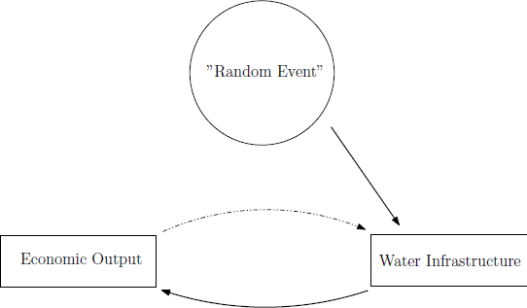
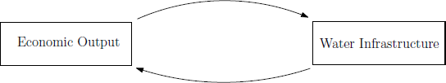
Random events can come from lots of sources: experimental variation, nature (“quasi-experimental” variation), arbitrary cutoffs in eligibility for a program, etc…

Slide 11
This is really important for policy: policy changes often occur is isolation of other changes.
- As a result, knowing causal relationships rather than correlations is extra important.

Slide 12

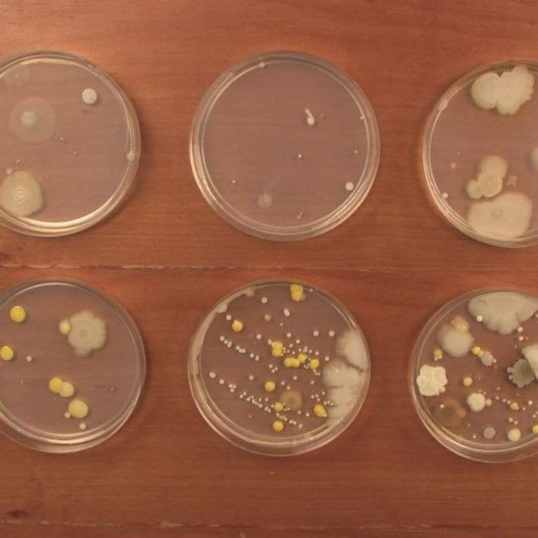
What is a counterfactual?
What would have happened had something else not happened.
Valuable in economics: 1) What would profits/welfare have been if my price had been 10% higher?
2) What would profits/welfare be if I shut down a division?
In law, it is the “but for” principle. Use of twins studies and lab experimental protocols to get good counterfactual.

Slide 13
Dube and Misra (2017)
Field Experiment at Ziprecruiter.com
Conversion rate decreases as prices increase.

Slide 14
Holladay, LaRiviere, Novgordsky and Price (2017)
Field Experiment with In Home Energy Audits
Audit probabilities increase with price subsidy

Slide 15
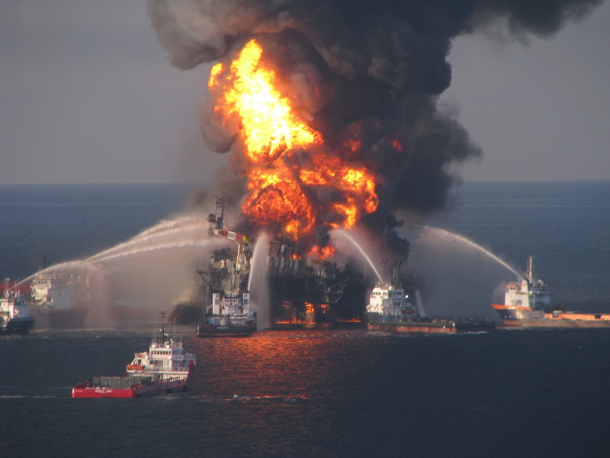
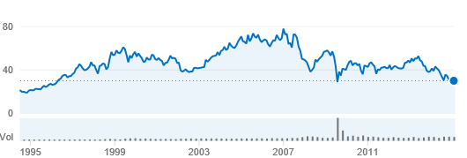
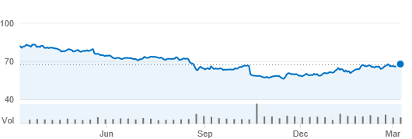
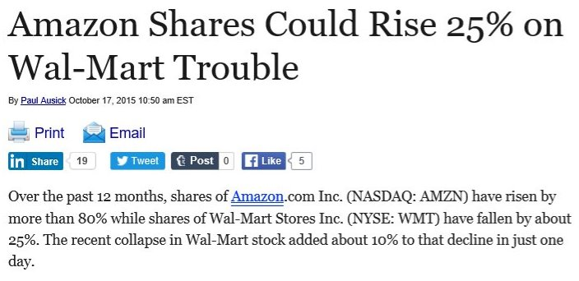
What’s in a counterfactual?
What was the impact of these events on the firms impacted by them?
We saw what happened.
What would have happened had these events not occurred and everything else remained constant?
What is the counterfactual?
BP’s share price, 1994-current
Walmart’s share price, March 2015-current

Slide 16
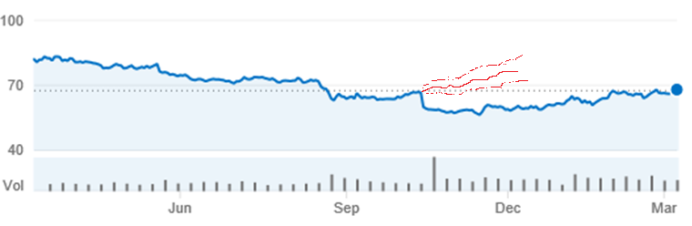
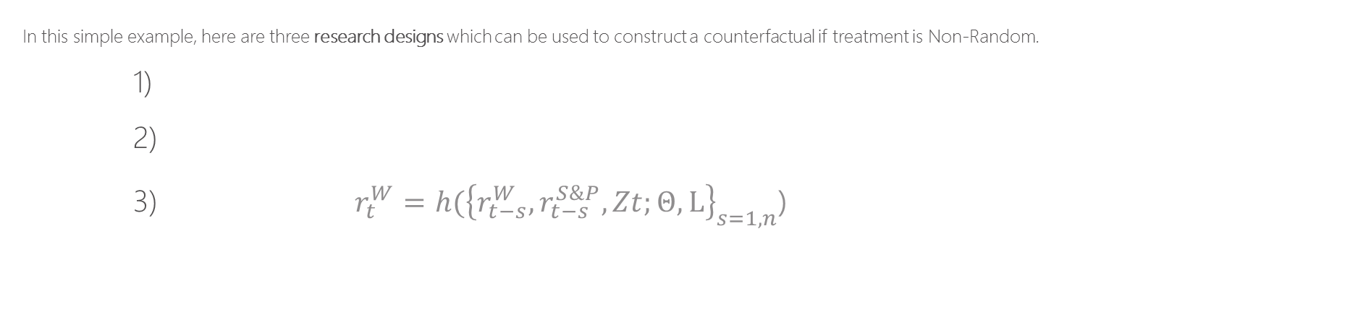
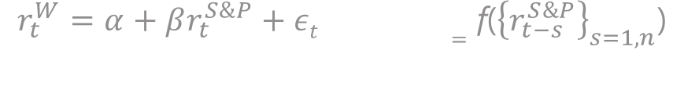
What’s in a counterfactual?
Walmart’s share price, March 2015-current
In this simple example, here are three research designs which can be used to construct a counterfactual if treatment is Non-Random.
1)
2)
3) $r_{t}^{W}=h({\left\{r_{t−s}^{W},r_{t−s}^{S\&P},Zt;Θ,L\right\}}_{s=1,n}$)
<- Benchmarking (differences-in-differences)
<- Time series (“simulated” counterfactual): estimate, compare
Traditionally used in economics
<- Kitchen sink (“Machine Learning”): train, test, treat, compare
$$r_{t}^{W}=α+βr_{t}^{S\&P}+εt =\text{f}\text{(}{\left\{r_{t−s}^{S\&P}\right\}}_{s=1,n}\text{)}$$
$r_{t}^{W}=ν+φr_{t−1}^{W}+εt =g({\left\{r_{t−s}^{W}\right\}}_{s=1,n}$)

Slide 17

What’s in a counterfactual?
Each method relies on assumptions for what can be inferred.
examples
- Benchmarking: in absence of event, the historical relationships are maintained
- All designs: nothing else occurred at time of event (Note: not true for Walmart example, EPS same day)
What is inference?
A precise characterization of what can be learned.
How much do dolphins love humans? Perhaps not at all…

Slide 18
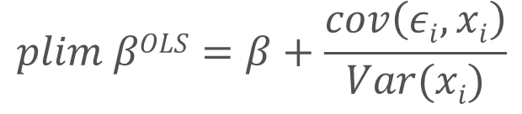
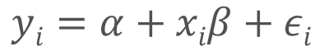
$$yi=α+xiβ+εi$$
$$plim βOLS=β+\frac{cov\left(εi,xi\right)}{Var(xi)}$$
$$cov\left(εi,xi\right) \begin{matrix}>0 →\text{biased} \text{up}\text{, }\text{positive} \text{selection}\text{ (}\text{innately} \text{talented} \text{goes} \text{to} \text{more} \text{school}\text{)} \\ =0 → \text{Unbiased}\text{ (}\text{this} \text{could} \text{be} \text{a} \text{fluke} \text{though}\text{!)} \\ <0 →\text{biased} \text{down}\text{, }\text{negative} \text{selection}\text{ (}\text{innately} \text{untalented} s\text{chool} \text{stuff}\text{)}\end{matrix}$$

Slide 19
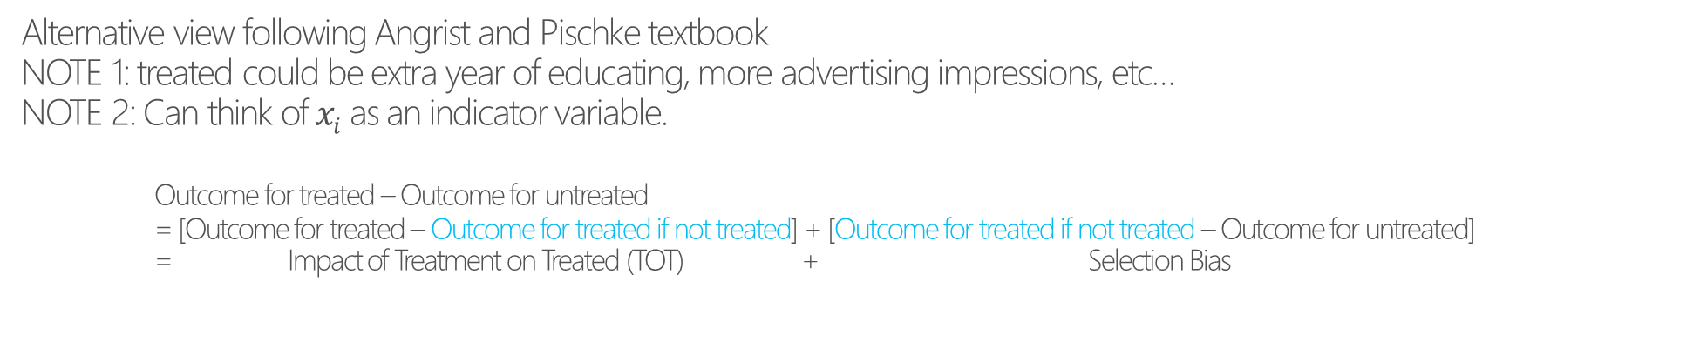
Alternative view following Angrist and Pischke textbook NOTE 1: treated could be extra year of educating, more advertising impressions, etc… NOTE 2: Can think of $xi$ as an indicator variable. Outcome for treated – Outcome for untreated = [Outcome for treated – Outcome for treated if not treated] + [Outcome for treated if not treated – Outcome for untreated] = Impact of Treatment on Treated (TOT) + Selection Bias
$$yi=α+xiβ+εi$$

Slide 20
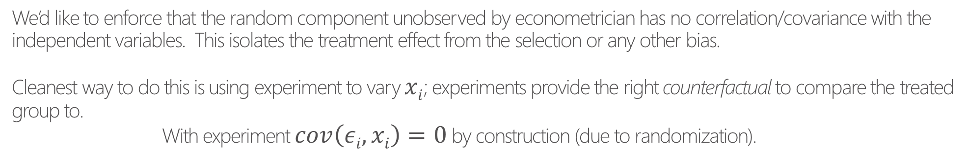
We’d like to enforce that the random component unobserved by econometrician has no correlation/covariance with the independent variables. This isolates the treatment effect from the selection or any other bias. Cleanest way to do this is using experiment to vary $xi$; experiments provide the right counterfactual to compare the treated group to. With experiment $cov\left(εi,xi\right)=0$ by construction (due to randomization).
$$yi=α+xiβ+εi$$
$$plim βOLS=β+\frac{cov\left(εi,xi\right)}{Var(xi)}$$

Slide 21
Randomness and Identification
Experiments don’t always have to be designed from the top down. Can use:
- Changes in internal goals, metrics, budgets
- Changes in policy (e.g., who is eligible for what prices)
- Changes in production costs
All of these affect prices without (hopefully) being systematically related to demand

Slide 22
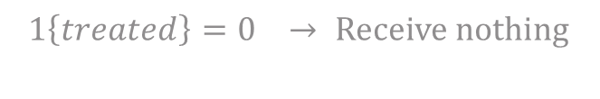
Example: What is causal impact of a sale
Consider the following experimental design regarding effectiveness of sale.
Assume store neighborhoods are “experimental unit”
$$1\left\{treated\right\}=1 → \text{Receive} \text{flyer} \text{with} \text{information} \text{about} \text{sale}$$
$$1\left\{treated\right\}=\text{0 }→ \text{Receive} \text{nothing}$$
$yi=α+1\left\{treatedi\right\}β+εi, \text{where} \hat{β} \text{is} \text{causal} \text{treatment} \text{effect} \text{but} \text{what} \text{is} \text{it}\text{?}$
Claim: This is a joint effect of advertising and price and therefore less informative.
Notes:
example insight from book
airlines leading example

Slide 23
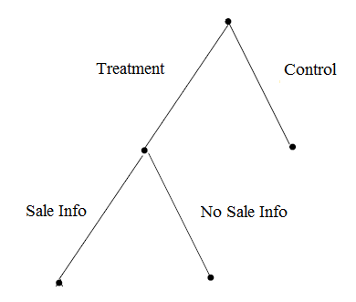
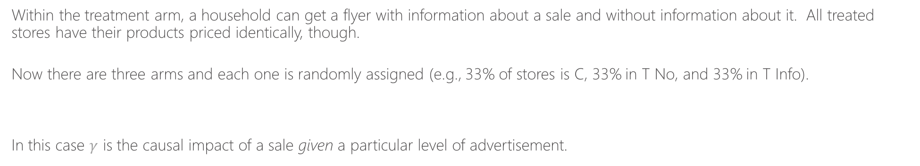
Example: What is causal impact of a sale
(receive flyer)
(doesn’t receive flyer)
Within the treatment arm, a household can get a flyer with information about a sale and without information about it. All treated stores have their products priced identically, though.
Now there are three arms and each one is randomly assigned (e.g., 33% of stores is C, 33% in T No, and 33% in T Info).
In this case $γ$ is the causal impact of a sale given a particular level of advertisement.
$$yi=α+1\left\{treatedi\right\}β+1\left\{Sale Infoi\right\}γ+εi$$
Notes:
example insight from book
airlines leading example

Slide 24
Misleading….
Call:
lm(formula = logmove.minute.maid ~ log(price.dominicks) * feat.dominicks +
log(price.minute.maid) * feat.minute.maid + log(price.tropicana) *
feat.tropicana, data = temp)
Residuals:
Min 1Q Median 3Q Max
-2.72433 -0.37421 -0.02269 0.34076 2.72813
Coefficients:
Estimate Std. Error t value Pr(>|t|)
(Intercept) 9.94534 0.04541 219.024 < 2e-16 ***
log(price.dominicks) 0.59255 0.03308 17.912 < 2e-16 ***
feat.dominicks -0.09239 0.03240 -2.852 0.00435 **
log(price.minute.maid) -2.42169 0.04360 -55.547 < 2e-16 ***
feat.minute.maid 1.83595 0.06239 29.427 < 2e-16 ***
log(price.tropicana) 0.58930 0.03681 16.010 < 2e-16 ***
feat.tropicana 0.70944 0.07637 9.290 < 2e-16 ***
log(price.dominicks):feat.dominicks 0.04523 0.06282 0.720 0.47149
log(price.minute.maid):feat.minute.maid -1.14745 0.08246 -13.915 < 2e-16 ***
log(price.tropicana):feat.tropicana -0.94700 0.08328 -11.371 < 2e-16 ***
---
Signif. codes: 0 ‘***’ 0.001 ‘**’ 0.01 ‘*’ 0.05 ‘.’ 0.1 ‘ ’ 1
Residual standard error: 0.5745 on 9639 degrees of freedom
Multiple R-squared: 0.6604, Adjusted R-squared: 0.6601
F-statistic: 2082 on 9 and 9639 DF, p-value: < 2.2e-16

Slide 25
EX: price “experiments”
Can be experiments over time (otherwise identical time periods, different prices) or over space (otherwise identical markets, different prices).
- Can use staggered rollouts of a price cut and a diff-in-diff design
Notes:
example insight from book
airlines leading example

Slide 26
EX: price “experiments”
Can be experiments over time (otherwise identical time periods, different prices) or over space (otherwise identical markets, different prices).
- Can use staggered rollouts of a price cut and a diff-in-diff design

Slide 27
EX: price “experiments”
Can be experiments over time (otherwise identical time periods, different prices) or over space (otherwise identical markets, different prices).
- Can use staggered rollouts of a price cut and a diff-in-diff design
Don’t actually need the time periods or markets to be identical, just identical apart from the things that you have data on and control for (e.g., can’t have lots of things moving around). Can find control groups if some things can’t be controlled for (e.g., time in this example.).
Notes:
example insight from book
airlines leading example

Slide 28
Quasi-experiments/Natural experiments
Experiments don’t always have to be designed from the top down. Can use:
- Changes in internal goals, metrics, budgets
- Changes in policy (e.g., who is eligible for what prices)
- Changes in production costs
All of these affect prices without (hopefully) being systematically related to demand

Slide 29
Example: What is causal impact of a sale
Consider the following experimental design regarding effectiveness of sale.
Assume store neighborhoods are “experimental unit”
$$1\left\{treated\right\}=1 → \text{Receive} \text{flyer} \text{with} \text{information} \text{about} \text{sale}$$
$$1\left\{treated\right\}=\text{0 }→ \text{Receive} \text{nothing}$$
$yi=α+1\left\{treatedi\right\}β+εi, \text{where} \hat{β} \text{is} \text{causal} \text{treatment} \text{effect} \text{but} \text{what} \text{is} \text{it}\text{?}$
Claim: This is a joint effect of advertising and price and therefore less informative.
Notes:
example insight from book
airlines leading example

Slide 30
Parametric versus non-parametric

Slide 31
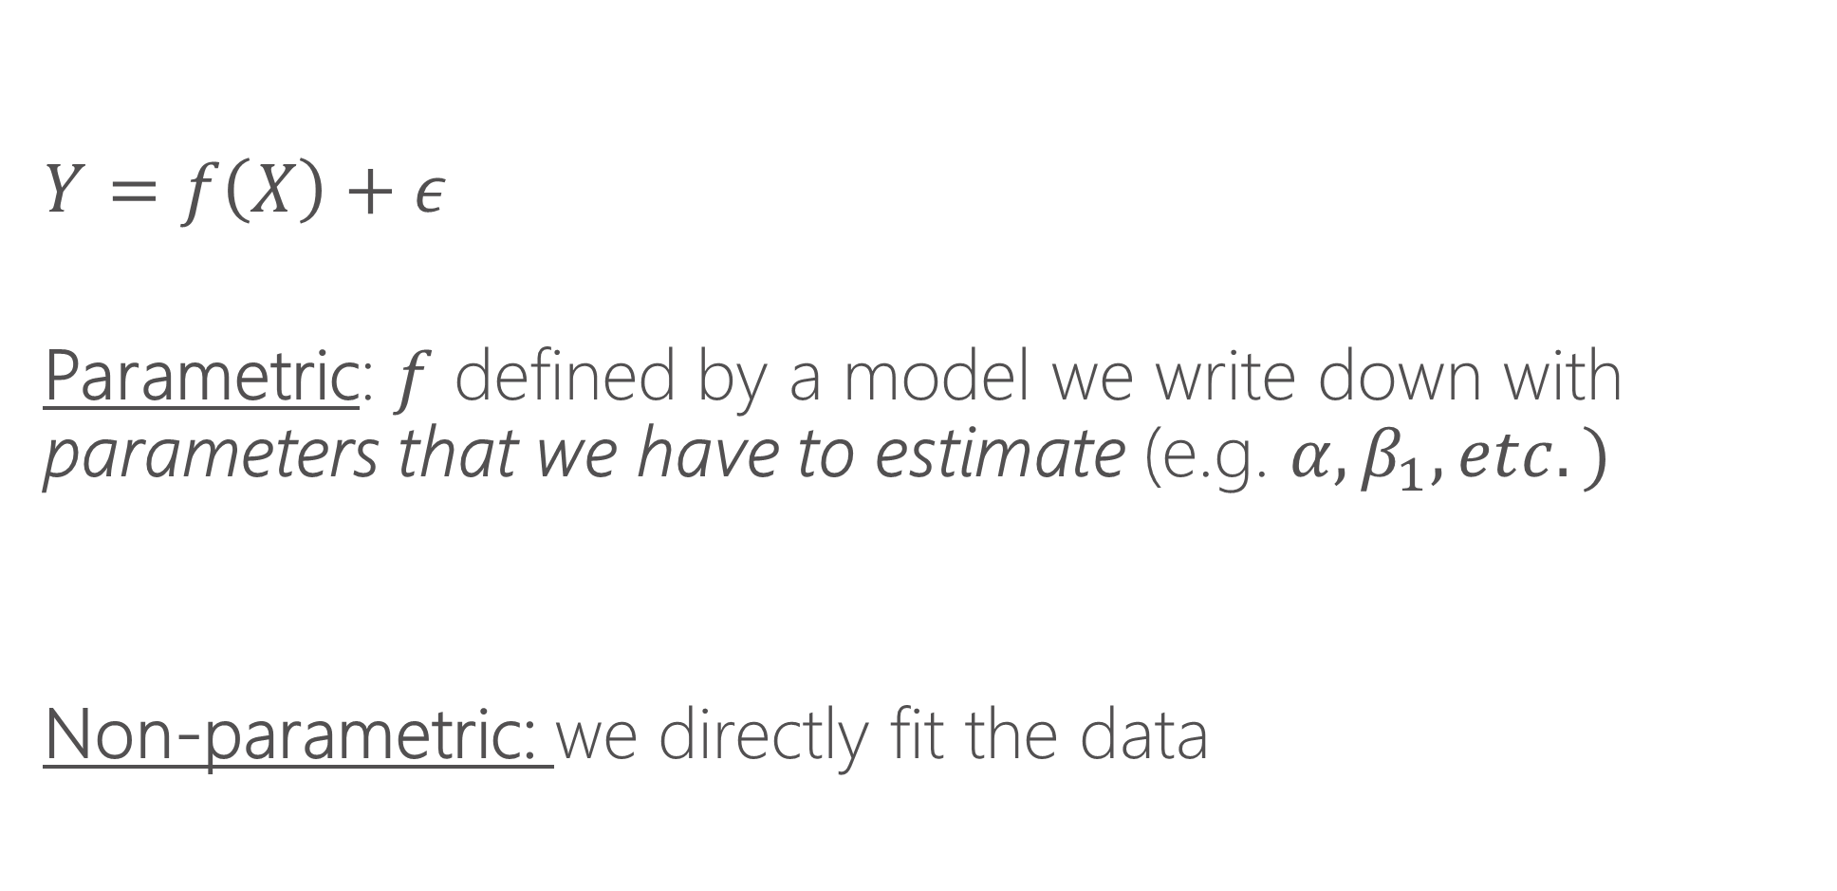
Parametric vs. non-parametric regression
$$Y=f\left(X\right)+ε$$
Parametric: $f$ defined by a model we write down with parameters that we have to estimate (e.g. $α, β_{1}, etc.)$
Non-parametric: we directly fit the data

Slide 32
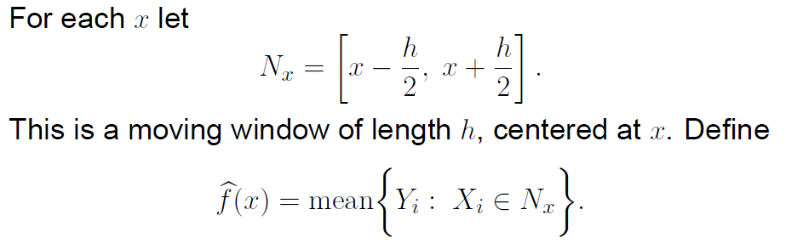
Local averaging

Slide 33
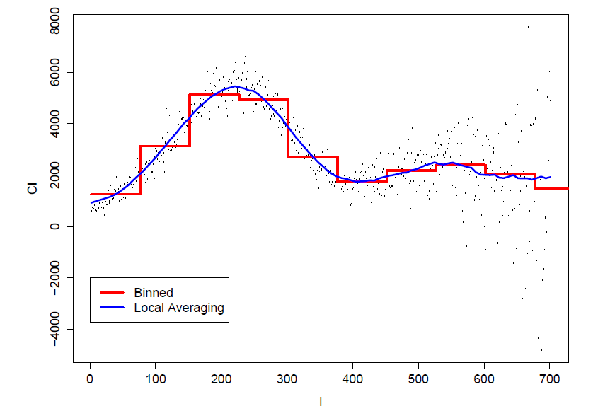
Local averaging vs. bins

Slide 34
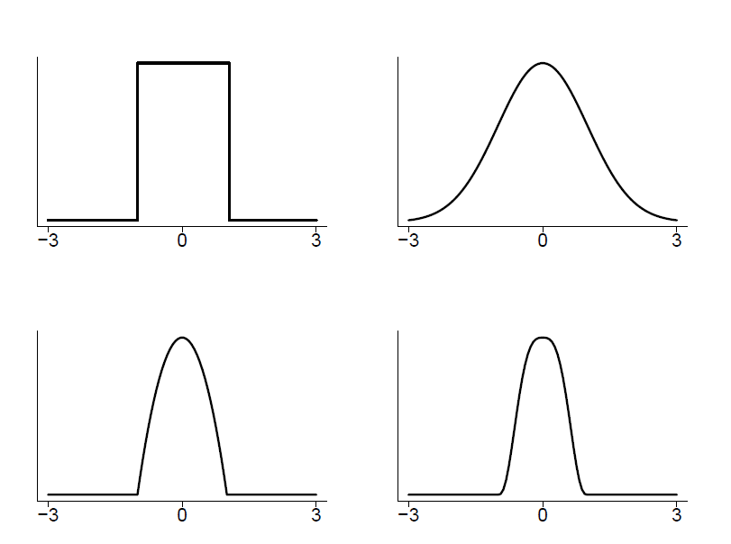
Kernels
A method of assigning higher weight to the points closer to the target point I am trying to fit.
Choice of kernel usually does not matter much.

Slide 35
Bandwidths
Bandwidths tell us how wide to make our kernel (window)
Larger bandwidths → smoother functions because there is more data used to make the averages
Bandwidth is sometimes called the smoothing parameter.
Bandwidths matter!

Slide 36
K-nearest neighbors
An alternative to bandwidths is instead of specifying a fixed window, we can say “use the nearest K nearest neighbors”
This ensures each bin has the same amount of data and can be a useful tool
Functionally it will often be quite similar to using a bandwidth, except when there are “sparse data” issues (then K-NNN is preferred)
Often expressed as a fraction of data. E.g. NN=.1 says “each bin is 10% of data”

Slide 37
Local polynomial regression
Thing of local averaging as fitting a constant for a given window of data
Instead of fitting a constant, we can fit a line (y=a*x + b) or a polynomial (y=a*x + b*x^2 + c), etc.
It is thus more general than local averaging, but very similar

Slide 38
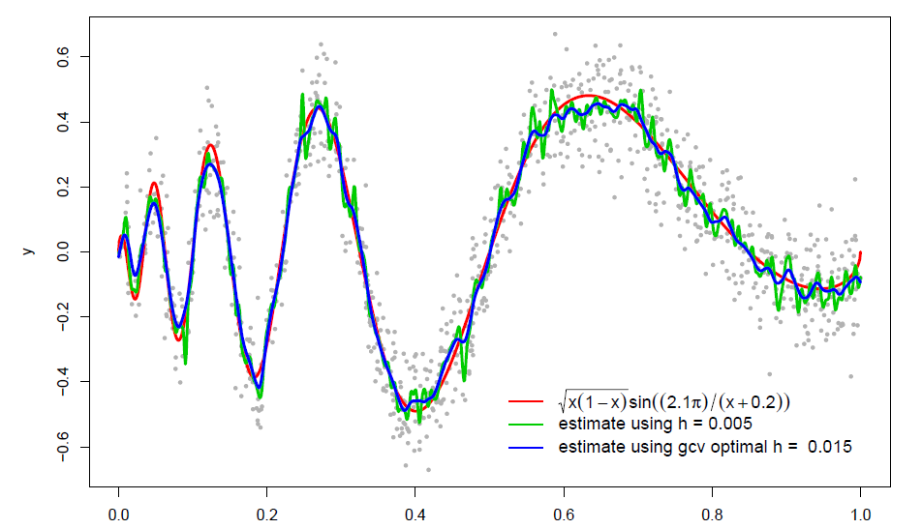
Some examples

Slide 39
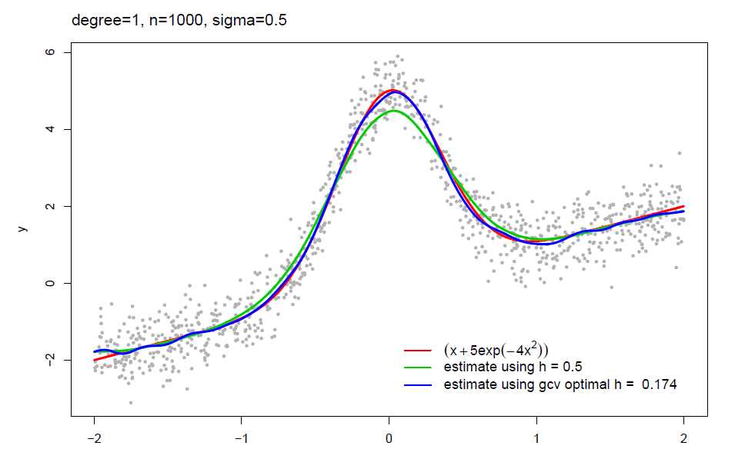
Some examples

Slide 40
Local polynomial in R locfit install.packages(locfit) library(locfit) Modeler needs to specify: bandwidth (or fraction of nearest neighbors), degree of the local polynomial Contrast: in parametric regression, we had to write down a model Aside: we’ll learn that non-parametric methods struggle in higher dimensions

Slide 41
When to use each model?
If there are a relatively small number of features (e.g. <4) then non-parametric makes a lot of sense.
With many features, the “curse of dimensionality” sets in and non-parametric methods fall apart (the “neighborhood” is generally empty)
Parametric models using interaction terms and polynomials are the preferred method with many features
“Semi-parametric” methods combine elements of both

